Slide 1
Monday, 2/21/22
Any Questions?
Exam 1 | Modules 1 – 10
Examity Appointment
Project 3
Weekly Assignments
Topics
Module 11 | Iterators
Module 12 | Dictionaries

Slide 2
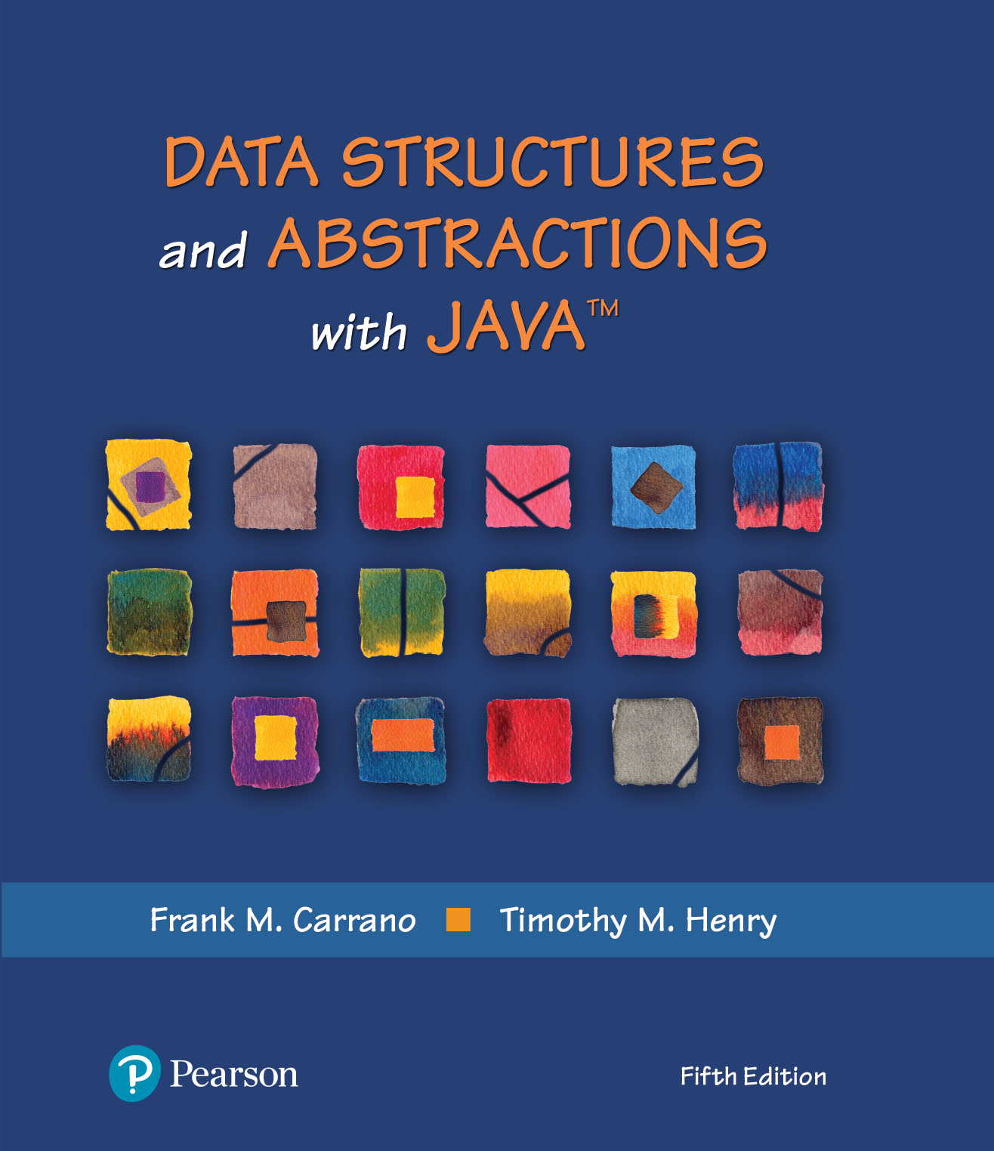
Iterators
Java Interlude 4 – Iterators
Chapter 13 - Iterators

Slide 3
Video Notes
Iterators
https://mediaplayer.pearsoncmg.com/assets/secs-vn-JI04-Iterators
Iterators As a Separate Class
https://mediaplayer.pearsoncmg.com/assets/secs-vn-ch13a-iterators-as-separate-class
Iterators As an Inner Class
https://mediaplayer.pearsoncmg.com/assets/secs-vn-ch13b-inner-class-iterators
Notes:
To maximize your learning experience, prepare for class prior each week

Slide 4
What Is an Iterator?
An object that traverses a collection of data
During iteration, each data item is considered once
Possible to modify item
Doesn’t it sound just like a loop?
Should implement as a distinct class that interacts with the ADT (What do we mean by this?)
References
https://www.geeksforgeeks.org/how-to-use-iterator-in-java/
https://docs.oracle.com/javase/8/docs/api/java/util/Iterator.html

Slide 5
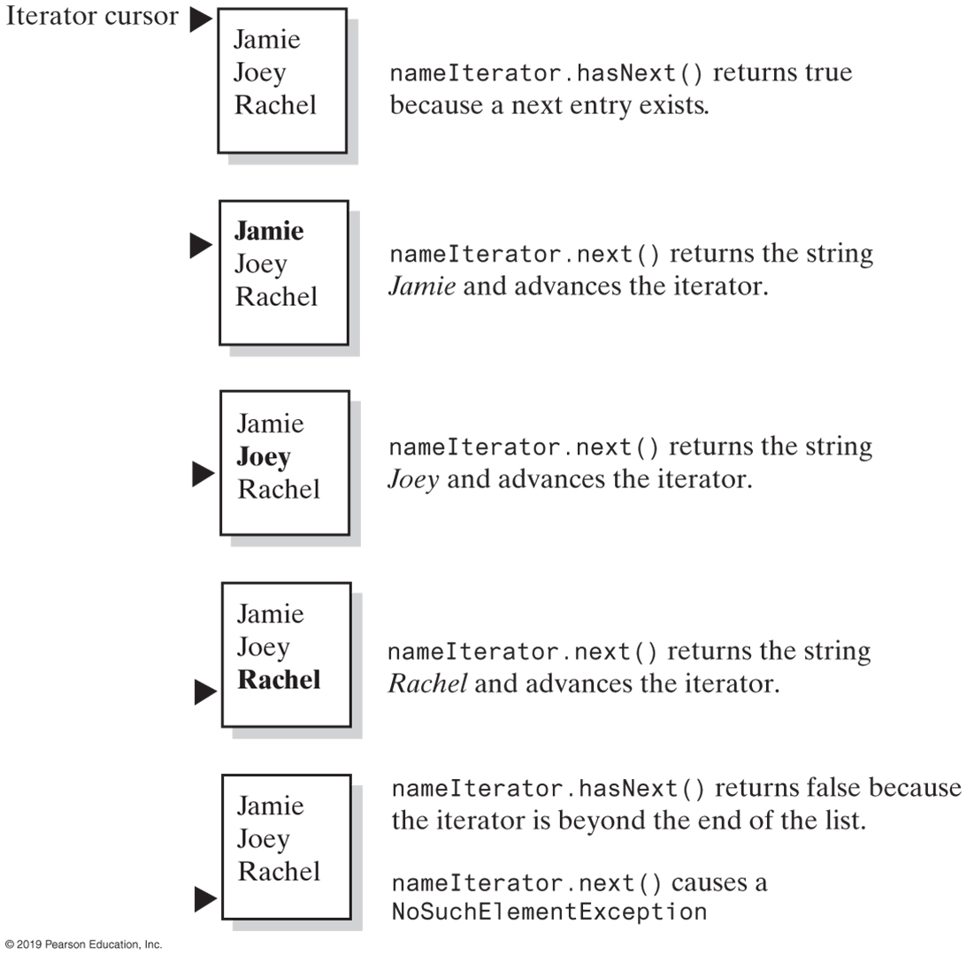
Using the Java Interface Iterator
Call hasNext() first
The effect of the iterator methods hasNext and next on a list
Notes:
This is our List (ADT)
hasNext() vs. next()
Same concept for a database

Slide 6
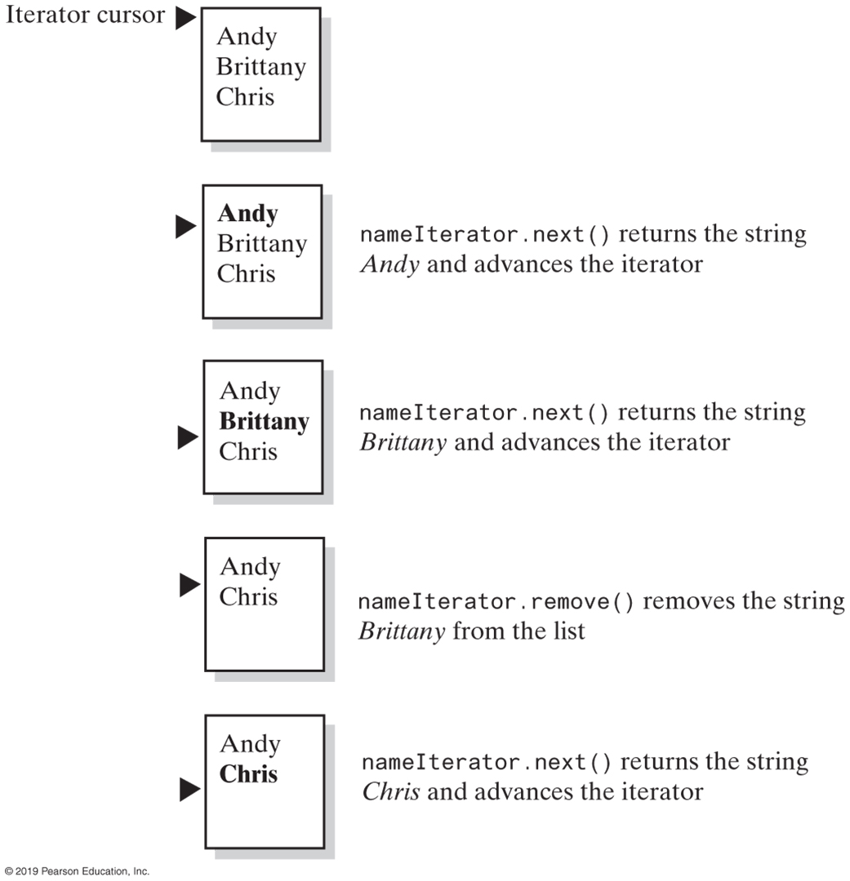
Using the Java Interface Iterator
This is more or less what you need to do for Lab 5
No need to perform remove() for Project 3
The effect of the iterator methods next and remove on a list
Notes:
This is how remove works

Slide 7
The Java Interface Iterator
package java.util;
public interface Iterator<T>
{
/** Detects whether this iterator has completed its traversal and gone beyond the last
entry in the collection of data.
@return True if the iterator has another entry to return. */
public boolean hasNext();
/** Retrieves the next entry in the collection and advances this iterator by one position.
@return A reference to the next entry in the iteration, if one exists.
@throws NoSuchElementException if the iterator had reached the
end already, that is, if hasNext() is false. */
public T next();
/** Removes from the collection of data the last entry that
next() returned. A subsequent call to next() will behave
as it would have before the removal.
Precondition: next() has been called, and remove() has not
been called since then. The collection has not been altered
during the iteration except by calls to this method.
@throws IllegalStateException if next() has not been called, or
if remove() was called already after the last call to next().
@throws UnsupportedOperationException if the iterator does
not permit a remove operation. */
public void remove(); // Optional method
} // end Iterator

Slide 8
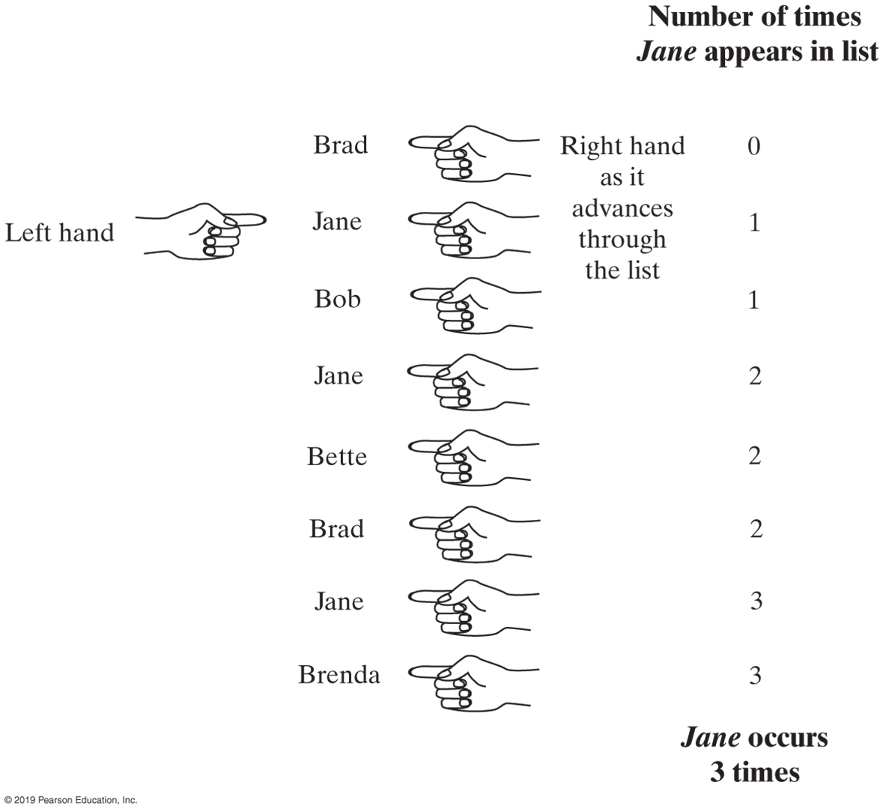
Jane appearing in a list of names
Using multiple iterators
Notes:
Count number of times Jane appears in a list of names
Purpose of using two iterators

Slide 9
Multiple Iterators
Iterator<String> nameIterator = namelist.iterator();
while (nameIterator.hasNext())
{
String currentName = nameIterator.next();
int nameCount = 0;
Iterator<String> countingIterator = namelist.iterator();
while (countingIterator.hasNext())
{
String nextName = countingIterator.next();
if (currentName.equals(nextName))
nameCount++;
} // end while
System.out.println(currentName + " occurs " + nameCount + " times.");
} // end while
Code that counts the occurrences of each name
Notes:
https://docs.oracle.com/javase/8/docs/api/java/util/ArrayList.html
ArrayList<String> namelist

Slide 10
Java Interface ListIterator
Iterator vs. ListIterator
Iterator can traverse the elements in the collection only in forward direction whereas, the ListIterator can traverse the elements in a collection in both the forward as well as the backwards direction
https://techdifferences.com/difference-between-iterator-and-listiterator-in-java.html
ListIterator
Method add inserts an entry into list just before iterator’s current position
Method remove removes list entry that last call to either next or previous returned
Method set replaces entry that either next or previous just returned
Notes:
https://docs.oracle.com/javase/8/docs/api/java/util/ListIterator.html
https://docs.oracle.com/javase/8/docs/api/java/util/Iterator.html

Slide 11
Java’s interface java.util.ListIterator (Part 1)
package java.util;
public interface ListIterator<T> extends Iterator<T>
{
/** Detects whether this iterator has gone beyond the last
entry in the list.
@return True if the iterator has another entry to return when
traversing the list forward; otherwise returns false. */
public boolean hasNext();
/** Retrieves the next entry in the list and
advances this iterator by one position.
@return A reference to the next entry in the iteration,
if one exists.
@throws NoSuchElementException if the iterator is at the end,
that is, if hasNext() is false. */
public T next();
/** Removes from the list the last entry that either next()
or previous() has returned.
Precondition: next() or previous() has been called, but the
iterator's remove() or add() method has not been called
since then. That is, you can call remove only once per
call to next() or previous(). The list has not been altered
during the iteration except by calls to the iterator's
remove(), add(), or set() methods.
@throws IllegalStateException if next() or previous() has not
been called, or if remove() or add() has been called
already after the last call to next() or previous().
@throws UnsupportedOperationException if the iterator does not
permit a remove operation. */
public void remove(); // Optional method
These three methods are in the interface Iterator; they are duplicated here for reference and to show new behavior for remove.

Slide 12
Java’s interface java.util.ListIterator (Part 2)
/** Detects whether this iterator has gone before the first entry in the list.
@return True if the iterator has another entry to visit when
traversing the list backward; otherwise returns false. */
public boolean hasPrevious();
/** Retrieves the previous entry in the list and moves this iterator back by one position.
@return A reference to the previous entry in the iteration, if one exists.
@throws NoSuchElementException if the iterator has no previous
entry, that is, if hasPrevious() is false. */
public T previous();
/** Gets the index of the next entry.
@return The index of the list entry that a subsequent call to
next() would return. If next() would not return an entry
because the iterator is at the end of the list, returns
the size of the list. Note that the iterator numbers
the list entries from 0 instead of 1. */
public int nextIndex();
/** Gets the index of the previous entry.
@return The index of the list entry that a subsequent call to
previous() would return. If previous() would not return
an entry because the iterator is at the beginning of the
list, returns −1. Note that the iterator numbers the
list entries from 0 instead of 1. */
public int previousIndex();

Slide 13
Java’s interface java.util.ListIterator (Part 3)
/** Adds an entry to the list just before the entry, if any, that next() would have returned before the
addition. This addition is just after the entry, if any, that previous() would have returned. After the
addition, a call to previous() will return the new entry, but a call to next() will behave as it would
have before the addition. Further, the addition increases by 1 the values that nextIndex() and
previousIndex() will return.
@param newEntry An object to be added to the list.
@throws ClassCastException if the class of newEntry prevents the
addition to the list.
@throws IllegalArgumentException if some other aspect of
newEntry prevents the addition to the list.
@throws UnsupportedOperationException if the iterator does not
permit an add operation. */
public void add(T newEntry); // Optional method
/** Replaces the last entry in the list that either next()
or previous() has returned.
Precondition: next() or previous() has been called, but the
iterator's remove() or add() method has not been called since then.
@param newEntry An object that is the replacement entry.
@throws ClassCastException if the class of newEntry prevents the
addition to the list.
@throws IllegalArgumentException if some other aspect of newEntry
prevents the addition to the list.
@throws IllegalStateException if next() or previous() has not been called,
or if remove() or add() has been called already
after the last call to next() or previous().
@throws UnsupportedOperationException if the iterator does not permit a set operation. */
public void set(T newEntry); // Optional method
} // end ListIterator

Slide 14
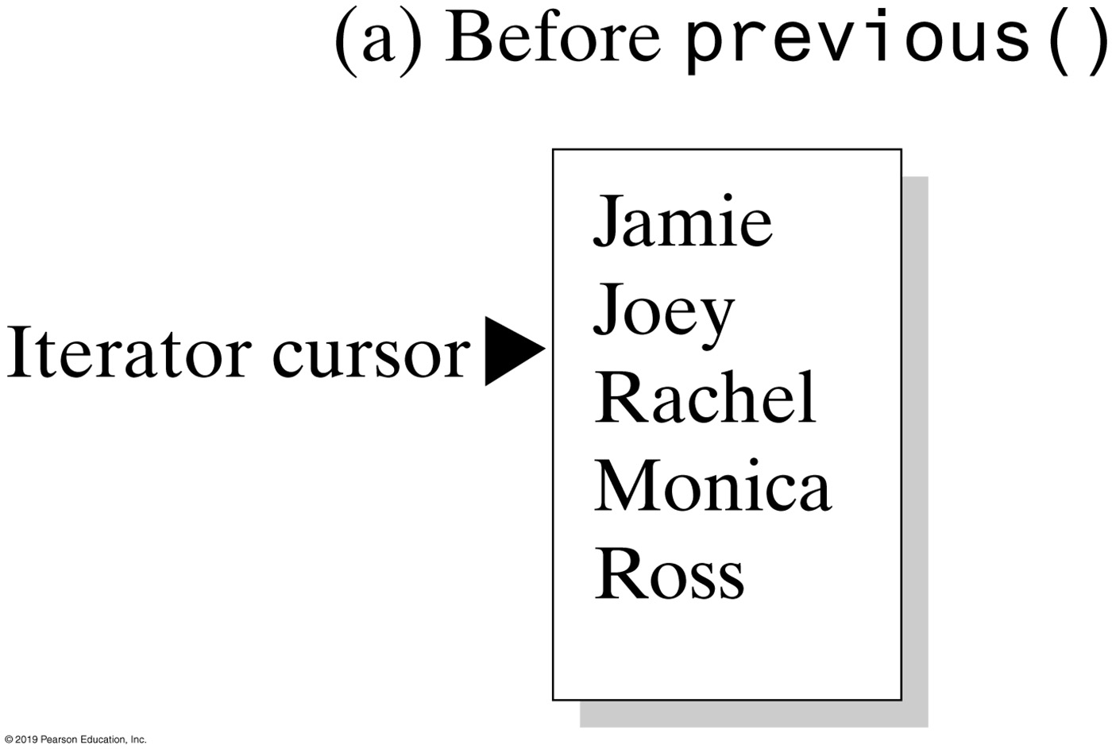
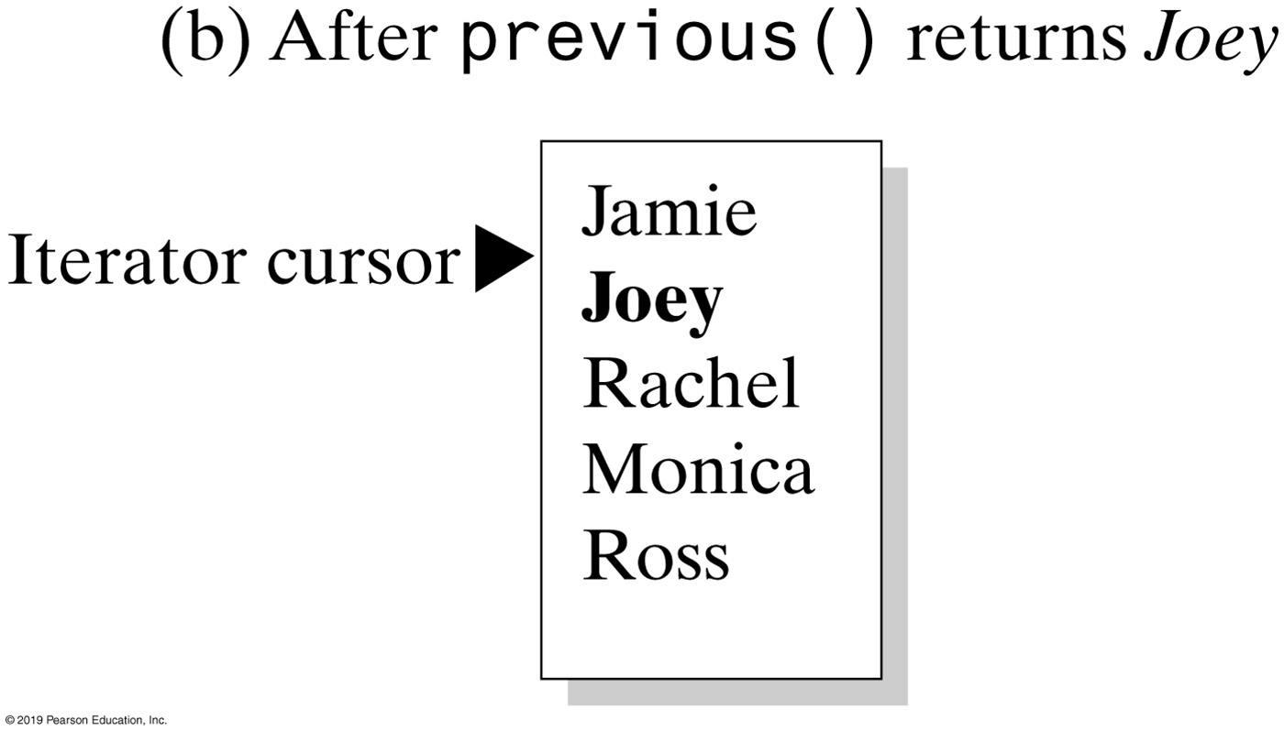
Using the Java Interface ListIterator
The effect of a call to previous on a list

Slide 15
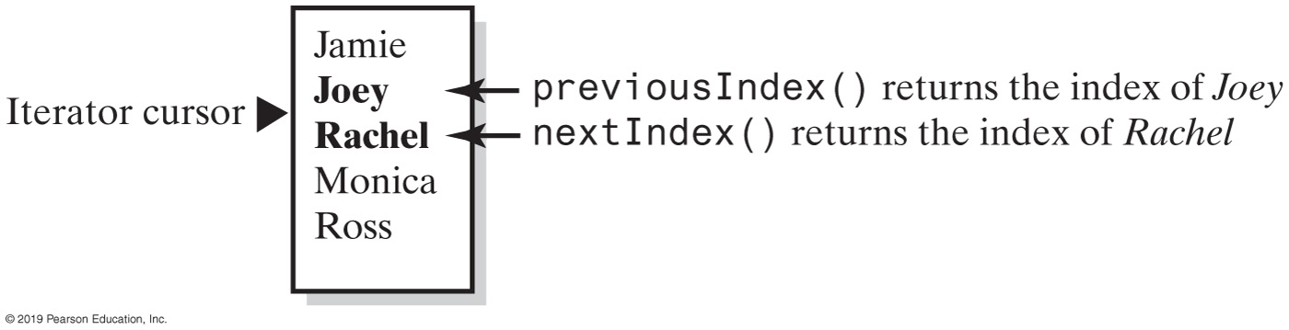
Using the Java Interface ListIterator
The indices returned by the methods nextIndex and previousIndex

Slide 16
Implementing an Iterator Class
Two techniques. The iterator class is defined
Inside the data structure class (as an inner class)
Maintains the data structure’s encapsulation
Called an internal iterator
Outside the data structure class
Allows the client to specify the name of the iterator objects
Iterator class can be used by multiple data structures
Implementation un-encapsulates the data structure
Called an external iterator
Same idea as nested classes
Notes:
Same idea as nested class

Slide 17
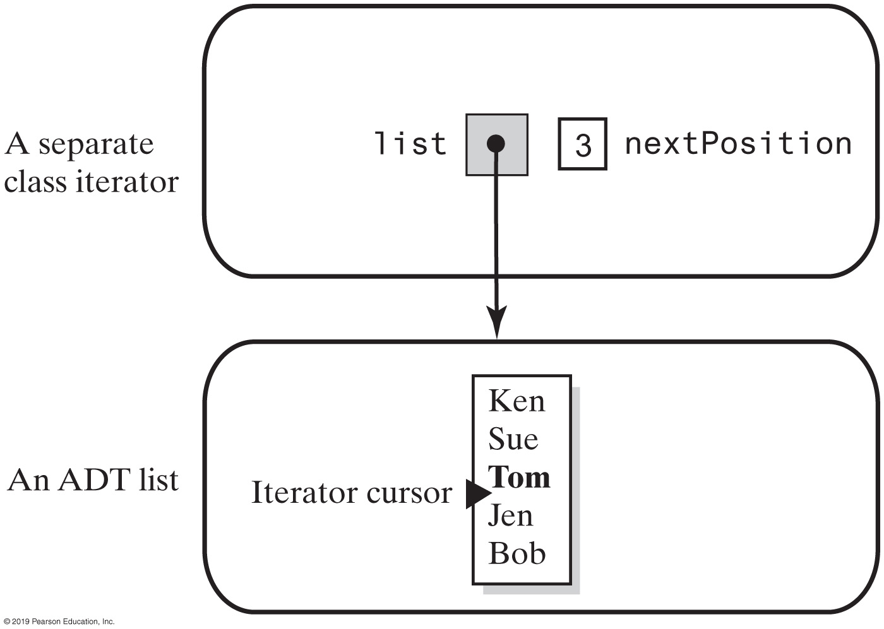
External Iterator – Separate Class
A separate class iterator with a reference to an ADT, an indicator of its position within the iteration, and no knowledge of the ADT’s implementation
Notes:
FIGURE 13-1
A separate class iterator with a reference to an ADT, an indicator of its position within the iteration, and no knowledge of the ADT’s implementation

Slide 18
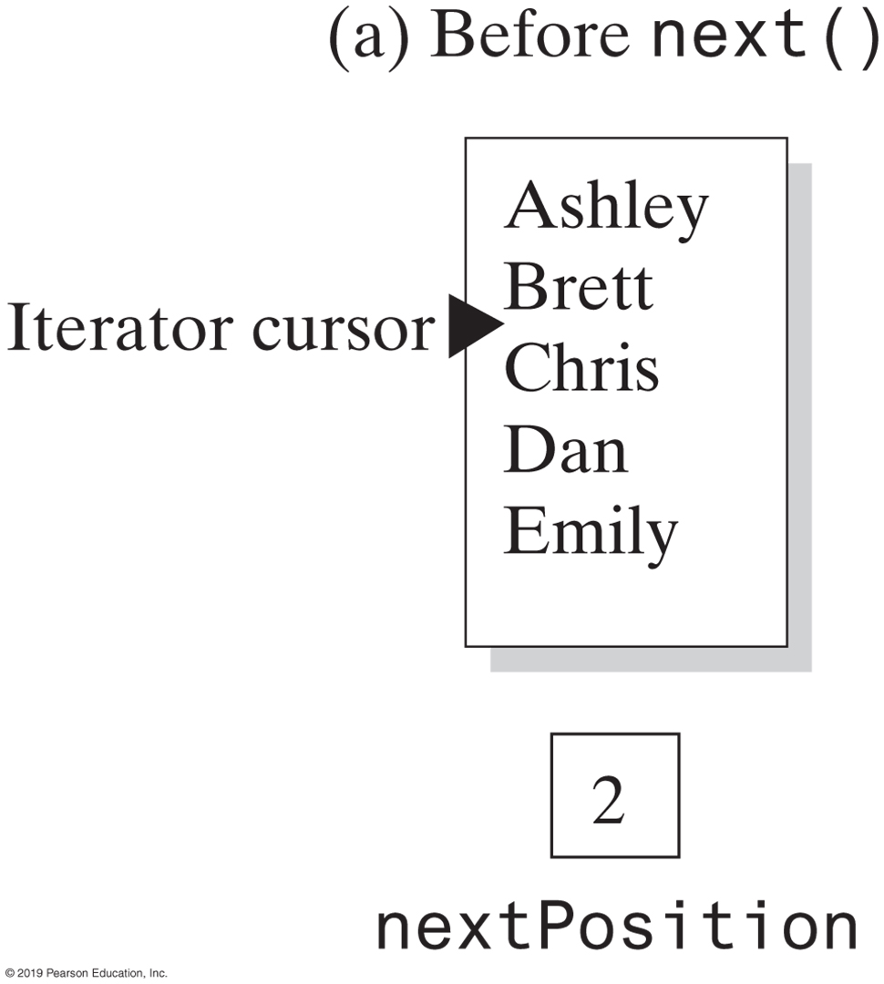
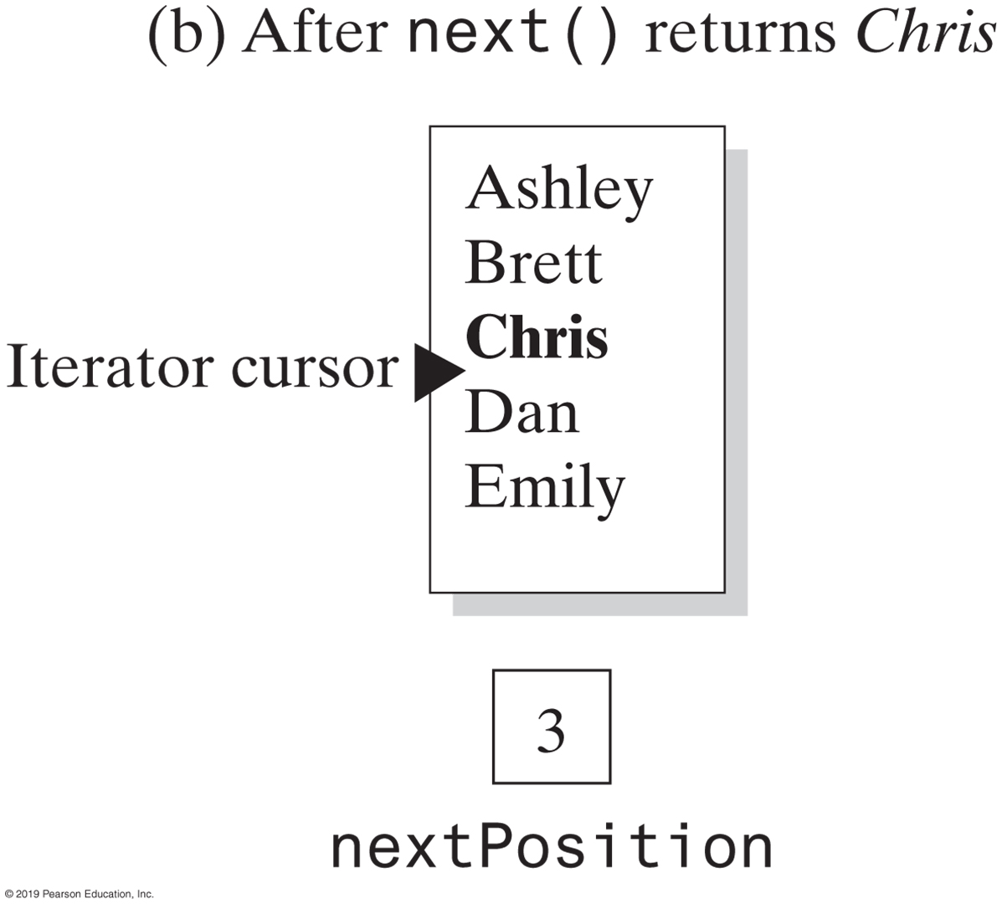
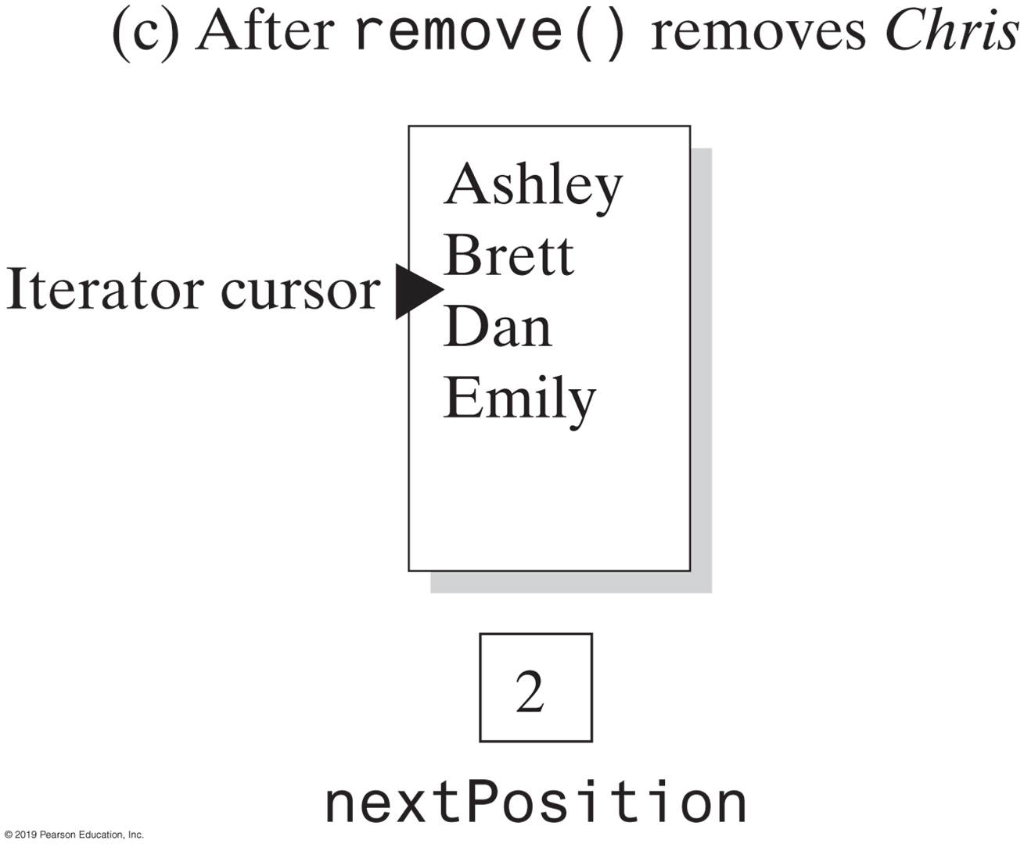
Separate Class Iterator
Changes to a list and nextPosition when removing Chris from the list

Slide 19
Separate Class Iterator
/** A class that represents an iterator for the ADT list. */
public class SeparateIterator<T> implements Iterator<T>
{
private ListInterface<T> list;
private int nextPosition; // Position of entry last returned by next()
private boolean wasNextCalled; // Needed by remove
public SeparateIterator(ListInterface<T> myList)
{
list = myList;
nextPosition = 0;
wasNextCalled = false;
} // end constructor
/* < Implementations of the methods hasNext, next, and remove go here. >
. . . */
} // end SeparateIterator
An outline of the class SeparateIterator

Slide 20
Separate Class Iterator
public T next()
{
if (hasNext())
{
wasNextCalled = true;
nextPosition++;
return list.getEntry(nextPosition);
}
else
throw new NoSuchElementException("Illegal call to next(); " +
"iterator is after end of list.");
} // end next
Implementation of next

Slide 21
Separate Class Iterator
public void remove()
{
if (wasNextCalled)
{
// nextPosition was incremented by the call to next(), so
// it is the position number of the entry to be removed
list.remove(nextPosition);
nextPosition--; // A subsequent call to next() must be
// unaffected by this removal
wasNextCalled = false; // Reset flag
}
else
throw new IllegalStateException("Illegal call to remove(); " +
"next() was not called.");
} // end remove
Implementation of remove

Slide 22
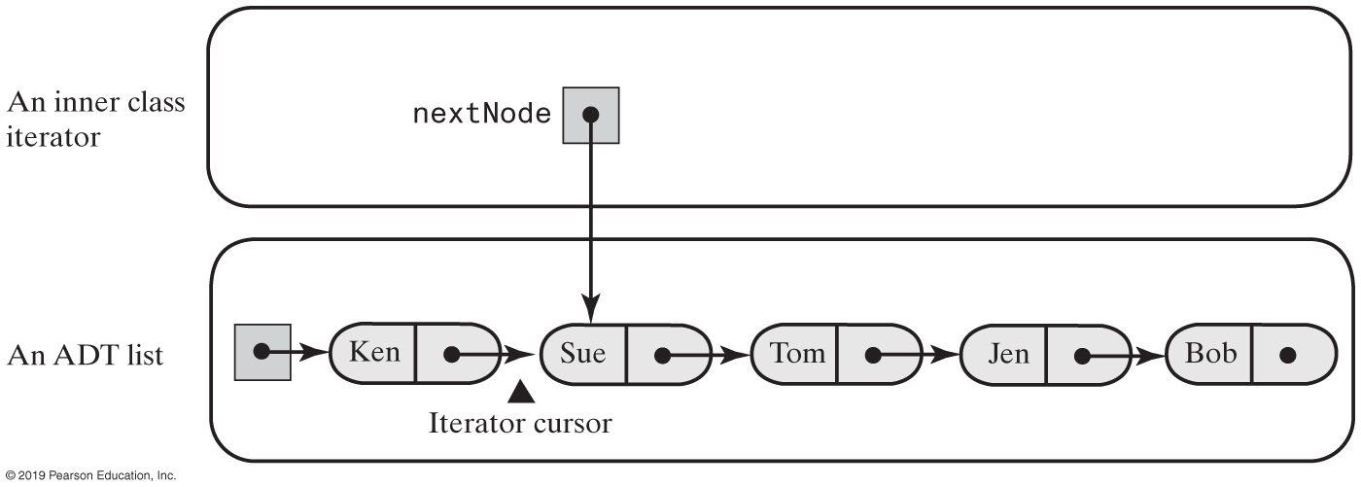
Internal Iterator – Inner Class
An inner class iterator with direct access to the linked chain that implements the ADT

Slide 23
Inner Class Iterator
/** An interface for the ADT list that has an iterator. */
public interface ListWithIteratorInterface<T>
extends ListInterface<T>, Iterable<T>
{
public Iterator<T> getIterator();
} // end ListWithIteratorInterface
The interface ListWithIteratorInterface

Slide 24
Inner Class Iterator (1 of 2)
/** A class that implements the ADT list by using a chain of linked nodes.
The list has an iterator. The class is similar to LList. */
public class LinkedListWithIterator<T> implements ListWithIteratorInterface<T>
{
private Node firstNode;
private int numberOfEntries;;
public LinkedListWithIterator()
{
initializeDataFields();
} // end default constructor
/* < Implementations of the methods of the ADT list go here; you can see them in Chapter 12,
beginning at Segment 12.7 > . . . */
public Iterator<T> iterator()
{
return new IteratorForLinkedList();
} // end iterator
public Iterator<T> getIterator()
{
return iterator();
} // end getIterator

Slide 25
Inner Class Iterator (2 of 2)
private class IteratorForLinkedList implements Iterator<T>
{
private Node nextNode;
private IteratorForLinkedList()
{
nextNode = firstNode;
} // end default constructor
// Implementations of the methods in the interface Iterator go here.
} // end IteratorForLinkedList
private class Node
{
// Implementations of the methods in inner class Node go here.
} // end Node
} // end LinkedListWithIterator
An outline of the class LinkedListWithIterator

Slide 26
Inner Class Iterator
public T next()
{
T result;
if (hasNext())
{
result = nextNode.getData();
nextNode = nextNode.getNextNode(); // Advance iterator
}
else
throw new NoSuchElementException("Illegal call to next(); " +
"iterator is after end of list.");
return result; // Return next entry in iteration
} // end next

Slide 27
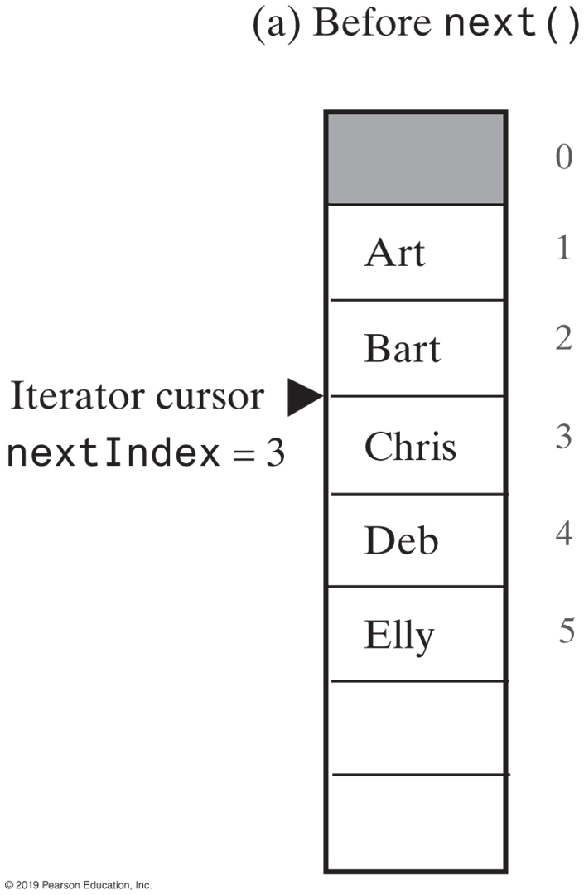
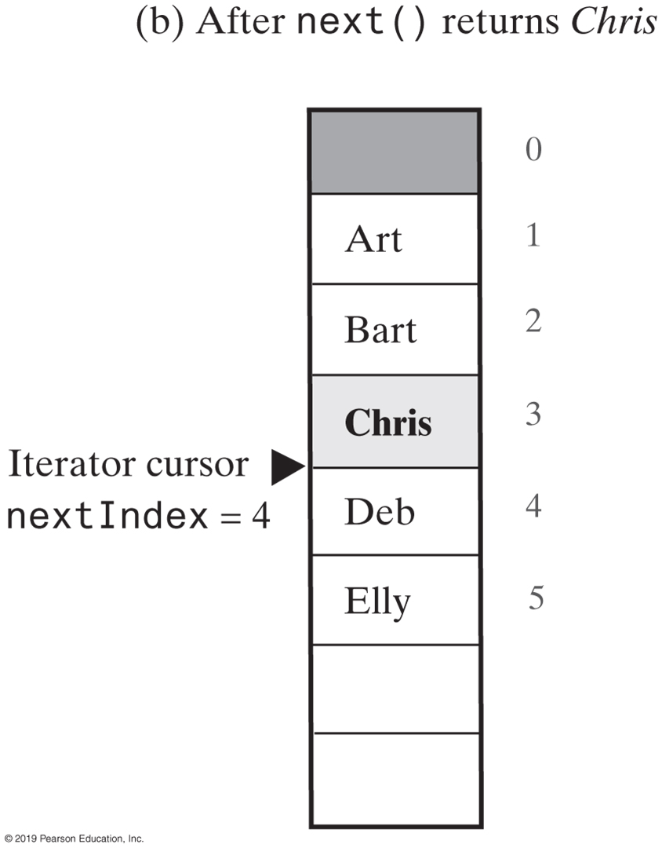
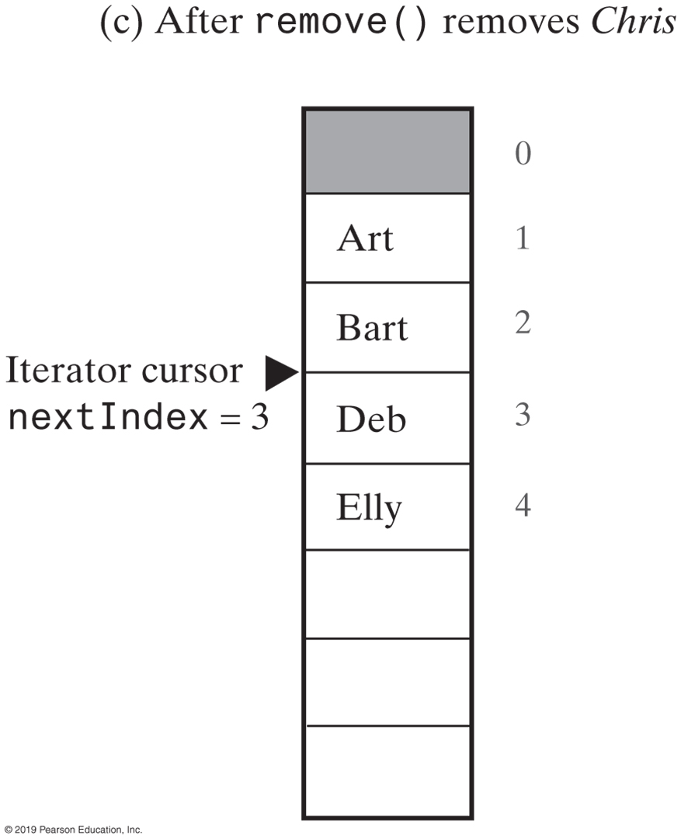
Iterators for Array-Based Lists
Changes to the array of list entries and nextIndex when removing Chris from the list

Slide 28
Iterators for Array-Based Lists (1 of 3)
/** A class that implements the ADT list by using a resizable array and gives it an iterator. */
public class ArrayListWithIterator<T> implements ListWithIteratorInterface<T>
{
private T[] list; // Array of list entries; ignore list[0]
private int numberOfEntries;
private boolean integrityOK = false;
private static final int DEFAULT_CAPACITY = 25;
private static final int MAX_CAPACITY = 10000;
public ArrayListWithIterator()
{
this(DEFAULT_CAPACITY);
} // end default constructor
An outline of the class ArrayListWithIterator

Slide 29
Iterators for Array-Based Lists (2 of 3)
public ArrayListWithIterator(int initialCapacity)
{
integrityOK = false;
// Is initialCapacity too small?
if (initialCapacity < DEFAULT_CAPACITY)
initialCapacity = DEFAULT_CAPACITY;
else // Is initialCapacity too big?
checkCapacity(initialCapacity);
// The cast is safe because the new array contains null entries
@SuppressWarnings("unchecked")
T[] tempList = (T[])new Object[initialCapacity + 1];
list = tempList;
numberOfEntries = 0;
integrityOK = true;
} // end constructor
/* < Implementations of the methods of the ADT list go here;
you can see them in Chapter 11, beginning at Segment 11.5. */
An outline of the class ArrayListWithIterator

Slide 30
Iterators for Array-Based Lists (3 of 3)
public Iterator<T> iterator()
{
return new IteratorForArrayList();
} // end iterator
public Iterator<T> getIterator()
{
return iterator();
} // end getIterator
private class IteratorForArrayList implements Iterator<T>
{
private int nextIndex; // Index of next entry in the iteration
private boolean wasNextCalled; // Needed by remove
private IteratorForArrayList()
{
nextIndex = 1; // Iteration begins at list's first entry
wasNextCalled = false;
} // end default constructor
// Implementations of the methods in the interface Iterator go here.
} // end IteratorForArrayList
} // end ArrayListWithIterator

Slide 31
Iterators for Array-Based Lists
public T next()
{
checkIntegrity();
if (hasNext())
{
wasNextCalled = true;
T nextEntry = list[nextIndex];
nextIndex++; // Advance iterator
return nextEntry;
}
else
throw new NoSuchElementException("Illegal call to next(); " +
"iterator is after end of list.");
} // end next
Method next

Slide 32
The Interface Iterable
package java.lang;
public interface Iterable<T>
{
/** @return An iterator for a collection of objects of type T. */
Iterator<T> iterator();
} // end Iterable
Notes:
https://docs.oracle.com/javase/8/docs/api/java/lang/Iterable.html
https://www.geeksforgeeks.org/java-implementing-iterator-and-iterable-interface/
https://www.techiedelight.com/differences-between-iterator-and-iterable-in-java/

